Slide 1
Effective Classroom Management in the English Language Classroom
Katie Bain
ktbain53@gmail.com
English Language Fellow

Slide 2
Objective
Participants will learn and practice using effective methodology and language tools to improve student access and success with language instruction.

Slide 3
DO NOW – Make a List
Well Run Classroom | Poorly Run Classroom
Notes:
Make a list with a partner or in groups of what a well-managed classroom looks like versus a poorly run classroom.

Slide 4
Pre-video Vocabulary Discussion
Agenda
Classroom logistics
Classroom management
Consequences\Rewards
Consistency
Established Framework
Facilitate
Identifier
Labeling
Proactive vs. Reactive
Lesson Plan Template
Peer Reinforcement

Slide 5
Agenda

Slide 6
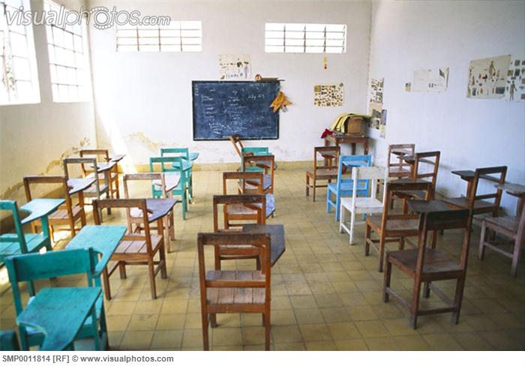
Classroom Logistics

Slide 7
Classroom Management

Slide 8
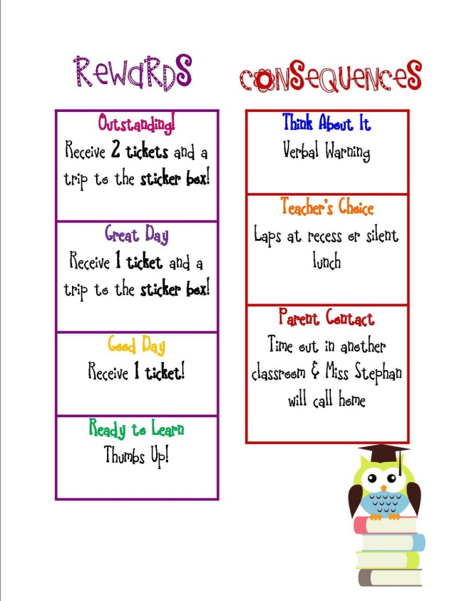
Consequences\Rewards

Slide 9
Consistency

Slide 10
Facilitate

Slide 11
Labeling

Slide 12
Proactive vs. Reactive

Slide 13
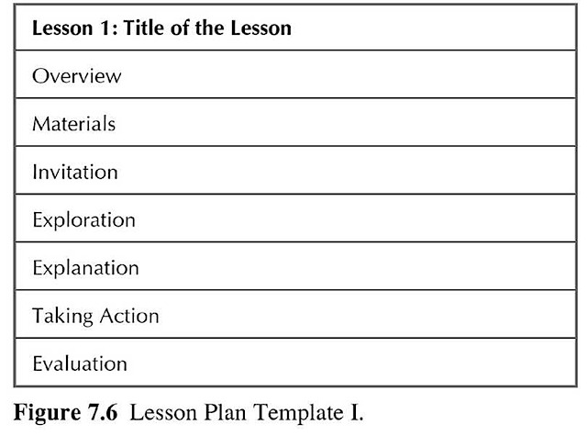
Lesson Plan Template

Slide 14
Peer Reinforcement

Slide 15
Personal Reflection
Consider your classroom environment
Noise level
Time management/Efficiency
Organization of Materials
Respect for the teacher and other students
Cleanliness
Learning level
Write down a comment or two about each aspect of your classroom

Slide 16
Examples
Noise Level
My classroom is noisy as students work hard on projects.
My classroom is noisy even when students need to hear me to listen to directions.
Time Management/Efficiency
Usually many students are finished while others are still working on pair work.
There is too much time between activities.

Slide 17
Video Viewing: “Managing Large Classes”
Video Segment #1: Pedagogical Planning
As you watch, list as many teacher suggestions as you can.
The second time through the segment, put a check after the things on your list that you see being done in the classroom pictured.
Compare your notes and observations with others.
How was the classroom in the video similar to and different from your classroom? Give examples.
Choose one technique from the video that you don’t use or that you use but could expand on. Share what you will do differently in your classroom with a partner and then with the class.

Slide 18
Video Viewing: “Managing Large Classes”
Video Segment #2: Classroom Learning Systems
During both viewings, notice physical organization of classroom space, student movement, class routines and teacher behaviors.
List the different ways that desks, chairs, equipment, and materials are placed in the room.
Notice the pattern of student movement and how it relates to class activity.

Slide 19
Video Viewing: “Managing Large Classes”
Video Segment #2: Classroom Learning Systems (Continued)
In your groups, discuss your observations about classroom organization. Discuss positives and negatives about different classroom setups.
Discuss things that you do in your classroom that are effective.
Discuss things from the video that you could or could or could not incorporate in your classroom and explain your reasoning.

Slide 20
Video Viewing: “Managing Large Classes”
Video Segment #3: Student Behavior (Discipline)
Teacher’s Ideas or Beliefs | Teacher Planning | Recommended Teacher Roles | Other?

Slide 21
Video Viewing: “Managing Large Classes”
Video Segment #3: Student Behavior (Discipline)
Compare your notes with others in your group. Add any you missed and discuss why you categorized them as you did.
Add your own ideas for what you do or could do in the classroom.
Share and write down discipline problems you have seen in your school. Discuss ways to deal with these problems.
Create a personalized list of strategies or techniques that you would like to begin, continue, or expand upon.

Slide 22
Action Plan!
Step 1: Think about how you could use new techniques to…
Use planning time more efficiently
Establish rapport with students
Provide individual attention to students
Deal with differences in student proficiency levels
Provide opportunities for students to produce and practice language
OR
Maintain control in such a way that enhances learning

Slide 23
Action Plan
Step 2: Design a portion of a lesson that includes the use of one or more of the techniques or activities on your list.
Step 3: Share your plan with others and get feedback to revise your plan.
Step 4: Share your plan with the whole group. As you listen to other groups, jot down new ideas!
Try your lesson plan in your classroom!

Slide 24
Source
Opp-Beckman, L., Klinghammer, S.J. (2006). Managing large classes. Shaping the Way We Teach. (57-64). Washington, D.C.: Office of English Language Programs.

