Slide 1
Improving Listening and Speaking with Free Online Tools
Katie Bain
English Language Fellow
Barranquilla, Colombia

Slide 2
Agenda
Principles of Listening and Speaking Instruction
“Computer-Assisted Language Learning”
(CALL) and Other Terms to Know
Why use Interent-Based Resources?
Learners as Generation Y
Merging Principles of Instruction and CALL
Activities for a Gen-Y Dominant Classroom

Slide 3
Components of Listening and Speaking Instruction
Meaning-focused input
Meaning-focused output
Language-focused learning
Fluency development
(Nation, I.S.P., Newton, J. (2009). Teaching ESL/EFL listening and speaking. Routledge, New York. )

Slide 4
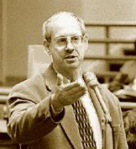
Meaning-focused Input
Receptive Skills
Students’ main focus is on making meaning, understanding, and comprehending the input they are receiving.
i + 1
(Nation, I.S.P., Newton, J. (2009). Teaching ESL/EFL listening and speaking. Routledge, New York. )

Slide 5
Meaning-focused Output
Productive Skills
This strand focuses on students producing meaningful meaningful speech that they can use in the real world.
(Nation, I.S.P., Newton, J. (2009). Teaching ESL/EFL listening and speaking. Routledge, New York. )

Slide 6
Language-focused Learning
Accuracy
Grammar
Pronuciation
Vocabulary
Punctuation
Spelling
(Nation, I.S.P., Newton, J. (2009). Teaching ESL/EFL listening and speaking. Routledge, New York. )

Slide 7
Getting to Fluency
Students make the best possible use of what they already know.
The students’ focus is on conveying and understanding meaning.
(Nation, I.S.P., Newton, J. (2009). Teaching ESL/EFL listening and speaking. Routledge, New York. )

Slide 8
Computer-Assisted Language Learning
Computer Aided Instruction (CAI)
The use of computer technology in the classroom
Computer Assisted Language Learning (CALL)
Computer technology for language learning
Computer-Mediated Communication (CMC)
The use of the computer technology to enhance speaking, listening, and pronunciation skills for language learning
(Chinnery, George M. . "Speaking and Listening Online: A Survey of Internet Resources." English Teaching Forum. 43.3 (2005): n. page. Web. 15 May. 2013.)

Slide 9
Merging Instructional Principles and CALL

Slide 10
1981-1999

Slide 11
Generation Y
Gen Yers …
are Digital Natives
want to work smarter, not harder
are kinesthetic and visual
are feedback dependent
love entertainment and games
customize tasks
seek a purpose and passion
(Reilly, Peter. "Understanding and teaching Generation Y." English Teaching Forum. 1 (2012): n. page. Web. 15 May. 2013.)
Notes:
As we I explain ideas and activities, consider how they would be appropriate for Gen Y or others in your classroom.

Slide 13
Online Listening and Speaking Tools
Receptive
Done by single or single group of users.
Students receive information from text, images, audio or video.
Interactive
Two or more users interact at the same time.
Students speak and respond to others in real time.
(Chinnery, George M. . "Speaking and Listening Online: A Survey of Internet Resources." English Teaching Forum. 43.3 (2005): n. page. Web. 15 May. 2013.)

Slide 14
Activities for a Gen-Y Dominant Classroom
Beginning Students
Intermediate Students
Advanced Students
(Chinnery, George M. . "Speaking and Listening Online: A Survey of Internet Resources." English Teaching Forum. 43.3 (2005): n. page. Web. 15 May. 2013.)

Slide 15
Beginning Level Activity
Listen to an audiofile as a class
Ask students a “gist” question:
Example: Was the story about the Internet or newspapers?
Listen again and again, with readiness prompts
Example: Listen for…the prediction of the future of the newspaper. List at least one prediction.
Example: On the Media
(Chinnery, George M. . "Speaking and Listening Online: A Survey of Internet Resources." English Teaching Forum. 43.3 (2005): n. page. Web. 15 May. 2013.)

Slide 16
Intermediate Level Activities
Teachers prepare T/F or multiple choice questions before listening to an audiofile
Students work in pairs or groups to create a headline for a story
Students script and record their own narration to match a topic.
Write a Headline for This Story
http://www.onthemedia.org/
(Chinnery, George M. . "Speaking and Listening Online: A Survey of Internet Resources." English Teaching Forum. 43.3 (2005): n. page. Web. 15 May. 2013.)

Slide 17
Advanced Level Activities
Students re-write and record a more simplified version of an audio segment.
Students discuss to compare and contrast two audio files on the same subject.
Example: Listen to a story on the same subject from CNN, MSNBC, and Fox News. Compare and contrast the differences in the way news is presented or how different networks present the same topic.
CNN IRS Scandal
Fox News IRS Scandal
MSNBC IRS Scandal
(Chinnery, George M. . "Speaking and Listening Online: A Survey of Internet Resources." English Teaching Forum. 43.3 (2005): n. page. Web. 15 May. 2013.)

Slide 18
Websites for Activities
Ready-to-Go
Create-Your-Own
www.esl-lab.com
www.literacynet.org/cnnsf
www.americanenglish.state.gov
http://www.voanews.com/
http://www.npr.org/
http://edition.cnn.com/
http://tv.msnbc.com/
http://video.nationalgeographic.com/video/kids/
http://www.timeforkids.com/photos-video

Slide 19
Interactive Listening/Chatting Options
www.englishclub.com/esl-chat
www.eslcafe.com
Skype
Google Hangout
Facebook Chat or Video Chat
Global Schoolhouse
(Chinnery, George M. . "Speaking and Listening Online: A Survey of Internet Resources." English Teaching Forum. 43.3 (2005): n. page. Web. 15 May. 2013.)

Slide 20
More Activities Consider the level of each and how they are tailored for Generation Y.
Cooperative Listening
Students listen to a news quip or story several times.
Students work together to answer questions and discuss listening strategies.
Example: http://StoryCorp Story
(Reilly, Peter. "Understanding and teaching Generation Y." English Teaching Forum. 1 (2012): n. page. Web. 15 May. 2013.)

Slide 21
Action-Packed Video Clip
Show an action-packed video clip.
Have students write and then share sentences about them with partners and then as a class.
Example: Indiana Jones Stunts
(Reilly, 2012)

Slide 22
Songs
Students bring songs to class and bring cloze activity handouts for them.
(Reilly, 2012)

Slide 23
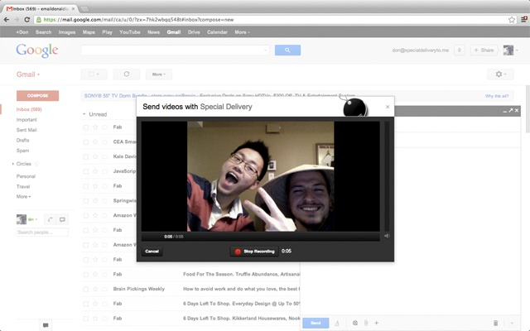
Digitally Recording Student Speech
Have students record and upload presentations on Youtube.
Record short utterances in class and have students send the videos to eachother and prepare and record responses as homework or classwork.
(Reilly, 2012)

Slide 24
Community Member Talk
Invite a friend or colleague to the class in person or via skype to discuss a topic that is important to the class (the environment, public health, education, crime, etc.).
Broadcast a Ted Talk.
Use the talk as a springboard for discussion and research in your classroom.
http://www.ted.com/
(Reilly, 2012)

Slide 25
What other ideas do you have?
Work in partners.
Use your cell phones to record other ideas for using the Internet to improve student Speaking and Listening using Online Tools.
Email them to ktbain53@gmail.com.
Videos will be uploaded to my blog!
(Your consent is necessary before doing so! ☺)

Slide 26
Sources
Chinnery, George M. . "Speaking and Listening Online: A Survey of Internet Resources." English Teaching Forum. 43.3 (2005): n. page. Web. 15 May. 2013.
Lowrey, Annie. "Do millenials stand a chance in the real world?." New York Times 31 March 2013, Sunday MM12. Web. 19 May. 2013.
Luzon Marco, Maria Jose. "Internet Content-Based Activities for English for Specific Purposes." English Teaching Forum. 1.1 (2002): n. page. Web. 15 May. 2013.
Nation, I.S.P., Newton, J. (2009). Teaching ESL/EFL listening and speaking. Routledge, New York.
Reilly, Peter. "Understanding and teaching Generation Y." English Teaching Forum. 1 (2012): n. page. Web. 15 May. 2013.

Slide 27
THANK YOU!
Katie Bain
ktbain53@gmail.com
www.elfellowkbain.wordpress.com
www.americanenglish.state.gov

