Slide 1
International Mindedness
in the I.B. Curriculum
By: Amy Lingenfelter

Slide 2
What is International Mindedness in the 21st Century Classroom?
“International-mindedness isn’t something that can be taught in discrete lessons on the odd Friday afternoon. It’s an entire ‘frame of mind’ and as such needs time to develop.”
--Steven Mark, Educational Director, International Primary …...Curriculum.

Slide 3
What is International Mindedness in the 21st Century Classroom?
It’s helping students to develop a deep awareness of:
Their own culture and identity.
Other people, cultures, countries and customs.
There is more than one reality that can be equally valid depending on who is viewing it!
“Cultural Duality”
Notes:
Their own culture and identity and that their own perspectives have largely developed within these boundaries.

Slide 4
What Exactly is Culture?
According to Webster’s Dictionary:
1. “Of or relating to a particular group of people and their habits, beliefs, values, traditions, etc.
2. “Of or relating to the fine arts (such as music, theatre, painting, etc.)

Slide 5
Spheres of Cultural Influence
Nation/Country
School/Community/Region/ Ethnic or Religious Group
Family/Friends/Peers
Individual

Slide 6
Let’s Play: “Can You Guess the Country”?
Look at the country on your partner’s back.
Start asking questions and treating that person as if he were from that country.
Ask the person questions about that country’s “culture.”
Do NOT mention the name of the country or give any hints about geographic region.
What stereotypes and generalizations did your partner use, if any?

Slide 7
What are the “6 F’s” of Culture?
Food
Films
Festivals/“Feriados”
Folklore
Famous people
Fashion
Notes:
Students often learn about internationalism from tourists or movies

Slide 8
Cultural Iceberg
6 Fs
True International Mindedness
“Deep” Culture

Slide 9
Delve Deeper to Promote True Cross-Cultural Understanding:
EXAMPLES:
Gender
Class/Social issues
Race
Religion and religious values
Family structures or types of communities
General cultural values
Complexity and diversity within cultural groups
Idiosyncrasies of daily life
Historical explanations of culture
Notes:
It is not enough to learn about others, students must consider difficult issues of social justice, power, and oppression in order to make changes in how they think about and relate to others.

Slide 10
Now Let’s Explore an Example Close to Home…

Slide 11
How Do You Think Our Students See Americans?
LET’S CHAT:
How do you think our non-American students see American people and culture in general?
Notes:
What would be the first things that come to mind?

Slide 12
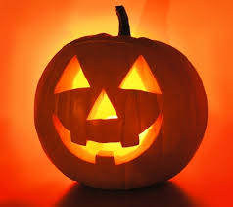
The “6 Fs” of American Culture:
Food. . .?
Films. . .?
Festivals/“Feriados”. . .?
Folklore. . .?
Famous people. . .?
Fashion. . .?

Slide 13
Now for the “Deeper Rooted” Aspects/Values of American Culture:
Individualism, Independence, Self-Reliance, and Privacy
Equality
Informality
The Future, Change, and Progress
The Goodness of Humanity
Time and Efficiency
Achievement, Results, Action, Work, and Materialism
Directness and Assertiveness

Slide 14
Instilling True “International Mindedness in Our Students”
LET’S CHAT:
What’s the difference between: 1) prejudices, 2) stereotypes, 3) generalizations, and 4) statistical summaries?
How do you encourage cultural inquiry in your students without perpetuating stereotypes?
How do we explore “deeper” and abstract cultural concepts with our students, especially to younger ones?

Slide 15
Framework for International Curriculum
Inquiries on Global Issues
Integration of International Experiences and Materials
Cross-Cultural Studies
Personal Cultural Identities
An true international curriculum!
Notes:
International experience could be the students visit an ethnic group in Ecuador and interview them, or in music class they make music with the traditional instruments of the indigenous people- that’s intergreating, that’s experiencing, that’s using authentic materials, reading individual anecdotes.

Slide 16
Multi-Cultural Activities and Materials in an Inquiry-Based Classroom
Aspects and perspectives of other cultures beyond the 6 F’s can be woven into classroom activities on a daily basis
“Engagements” and materials reflecting a wide range of cultural perspectives:
Without preference or bias
Authentic experiences
Allow students to explore and understand the reasoning and validity behind opposing perspectives
Notes:
Authentic experiences can be field trips to visit indigenous groups where students have to interview them, individual anecdotes

Slide 17
Inquiry-Based Learning: Delve Deeper
EXAMPLES:
Gender
Class/Social issues
Race
Religion and religious values
Family structures or types of communities
General cultural values
Complexity and diversity within cultural groups
Idiosyncrasies of daily life
Historical explanations of culture

Slide 18
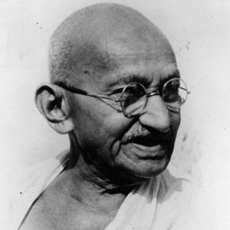
Inquiry-Based Learning: Global Issues and Taking Action
EXAMPLES:
Violence
Human rights and social justice
Environmental degradation
Overpopulation
Poverty
Language loss
Race and ethnicity
Economic imperialism
Notes:
Examples: 12-years old engage in an inquiry about prejudice, examining both historical contexts and their own community and interpersonal relationships, or 7-year-olds study language diversity, examining where and when they used particular languages and dialects and differing attitudes of their communities towards these languages, or 14 year olds examine the influence of popular culture through critiquing how race and gender are handled in cartoons and Disney films.

Slide 19
Reading & Researching Multiculturally
Encourage students to:
Recognize that culture, race, class, and gender affect how we interpret and analyze what we read and experience.
“Wrestle with ideas and words” with a critical eye, not just “walk on top of them.”
“Go deeper:” ask the WHY and HOW of cultural phenomena.
Realize that there is no one way of being, acting, or thinking: there are multiple truths.
Notes:
Their own culture and identity and that their own perspectives have largely developed within these boundaries.

Slide 20
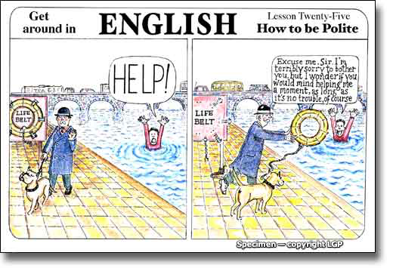
Your Turn. . .
EXAMPLE TASK: In small groups, please discuss ways that you could guide students to explore the American cultural value of directness in an inquiry-based, internationally- minded second-grade classroom. . .

Slide 21
THANKS FOR LISTENING!
Questions?
Comments?

