Slide 1
Tackling English Pronunciation
Presented By: Amy E. Lingenfelter

Slide 2
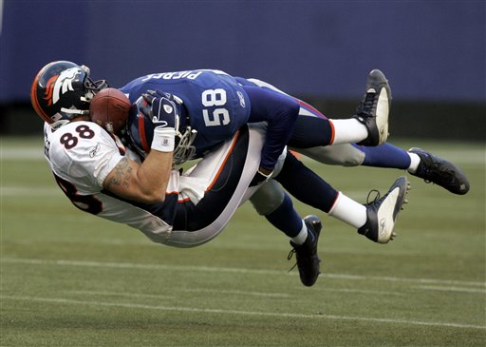
Tackling English Pronunciation

Slide 3
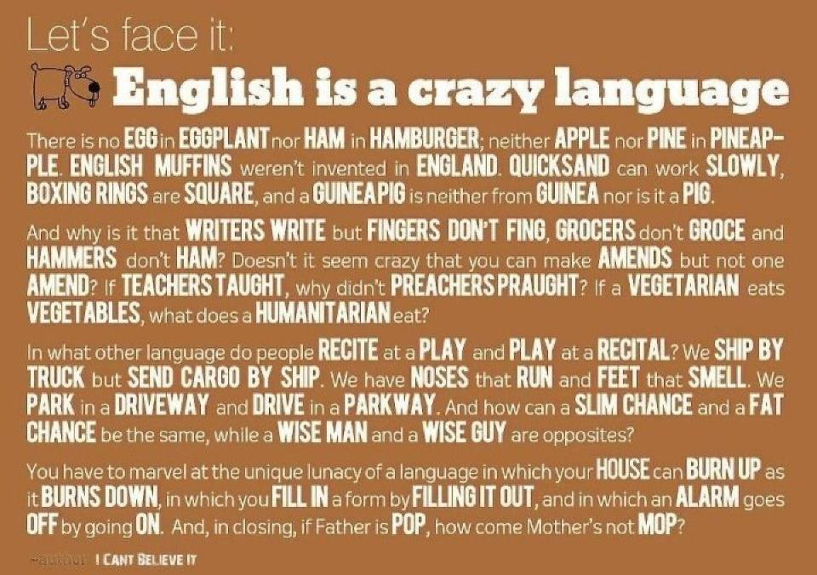

Slide 5
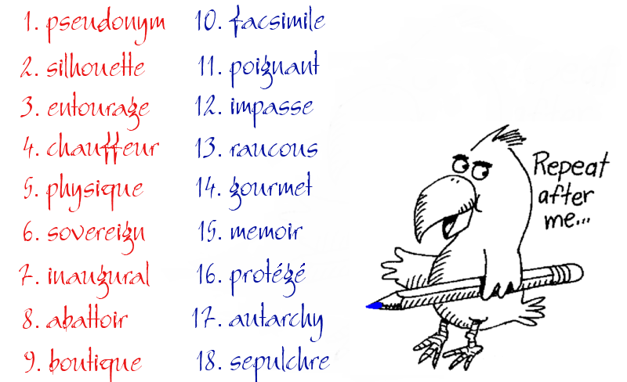

Slide 6
Overview of Course
Day/Step 1: Overview, warm up, voiced vs. voiceless consonants, phonetic symbols
Day/Step 2: Consonants
Day/Step 3: Consonant Clusters
Day/Step 4: Vowels
Day/Step 5: Vowel Clusters
Day/Step 6: Stress and Rhythm
Day/Step 7: Sounds in Connected Speech
Day/Step 8: Intonation
Day/Step 9: Sounds and Grammar
Day/Step 10: Pronouncing Written Words
Day/Step 11: Informal Speech and Idioms
Day/Step 12: Wrap up/Practice Test/Review

Slide 7
Today’s Class
Introduction
Class Self-Assessment
Icebreaker
Class Discussion: Agree or Disagree?
Introduction to Overall Pronunciation of Consonants
Introduction to Phonetic Symbols

Slide 8
Discuss With a Partner:
Why Did You Come to This Class?

Slide 9
Feeling-o-Meter
How are you feeling right now about this class?

Slide 10
Like this?

Slide 11
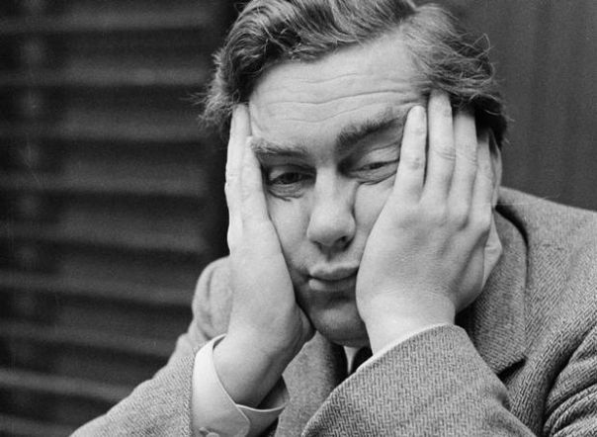
Or like this?

Slide 12
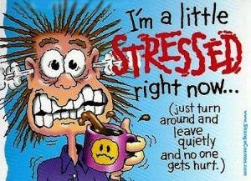
Or like THIS?

Slide 13
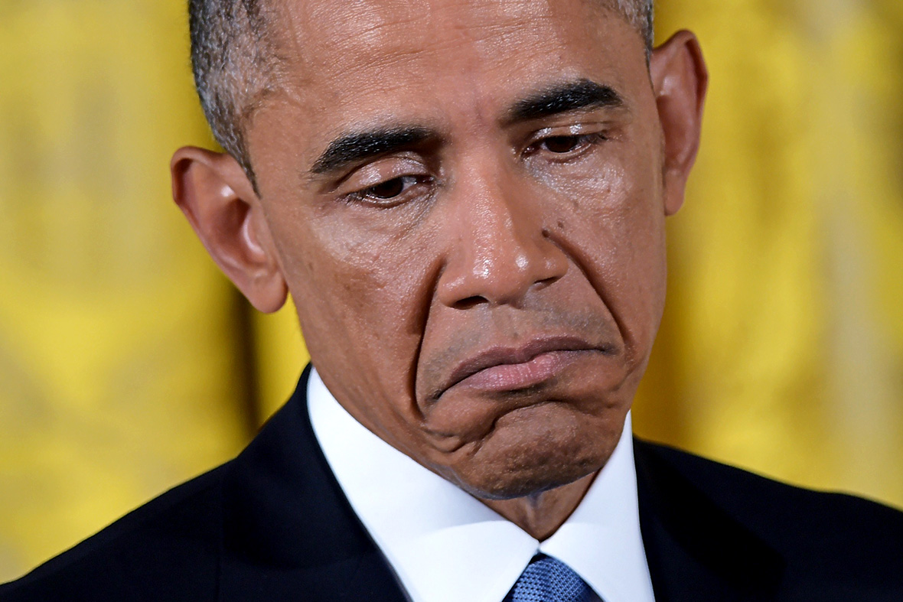
Or perhaps like THIS???

Slide 14
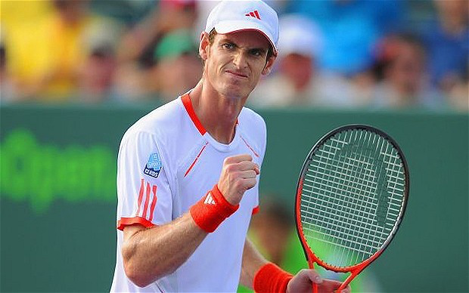
Or maybe like this!

Slide 15
Or even like THIS???

Slide 16
Let’s Take a Vote:
What do you feel are your biggest weaknesses in terms of English pronunciation?
What are your biggest strengths?
What would you like to improve during this class? (What would YOU like to most get out of this class?)

Slide 17
Let’s Take a Vote (Choose 1-2):
Topic (I Want to Improve) | Number of Votes
Overall pronunciation of words I know
Informal/casual language
To speak exactly like a native speaker
Technical or formal pronunciation
How to pronounce unknown written words
Expressions and idioms
Listening/Conversation skills

Slide 18
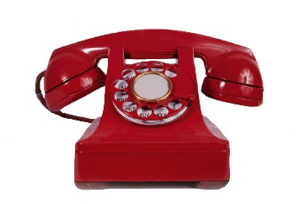
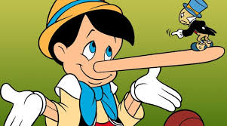
Icebreaker:
“2 Truths and a Lie Telephone”

Slide 19
Icebreaker:
“2 Truths and a Lie Telephone”
I will say 2 truths about myself and one lie.
Then I will pass around ONE of the truths via the telephone game.
Then the rest of the class has to guess which one is the lie.

Slide 20
Icebreaker:
“2 Truths and a Lie Telephone”
I have jumped out of an airplane
I lived in Venezuela
I have been married twice

Slide 21
Let’s Discuss:
“It’s important to speak as much like a native speaker of English as possible.”
“It’s OK to have an accent as long as you can be understood by most native and non-native English speakers.”
Move to one side or the other.
Do you agree or disagree with the quotation above? Use specific reasons and examples to explain your position.

Slide 22
Let’s Discuss in Rotation Circles:

Slide 23
Introduction to Phonetic Symbols
Now for the
scientific stuff. . .

Slide 24
Voiced vs. Voiceless Consonants

Slide 25
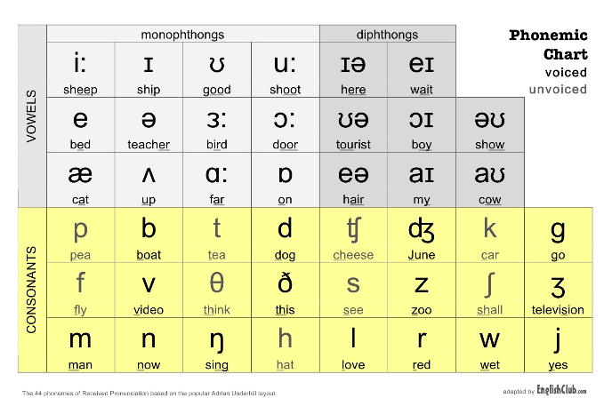
Introduction to Phonetic Symbols

