Slide 1
Tackling English Pronunciation
Presented By: Amy E. Lingenfelter

Slide 2
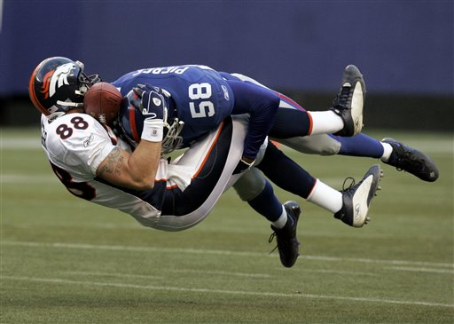
Tackling English Pronunciation

Slide 3
Overview of Course
Day/Step 1: Overview, warm up, voiced vs. voiceless consonants, phonetic symbols
Day/Step 2: Consonants
Day/Step 3: Consonant Clusters
Day/Step 4: Vowels
Day/Step 5: Vowel Clusters
Day/Step 6: Stress and Rhythm
Day/Step 7: Sounds in Connected Speech
Day/Step 8: Intonation
Day/Step 9: Sounds and Grammar
Day/Step 10: Pronouncing Written Words
Day/Step 11: Informal Speech and Idioms
Day/Step 12: Wrap up/Practice Test/Review

Slide 4
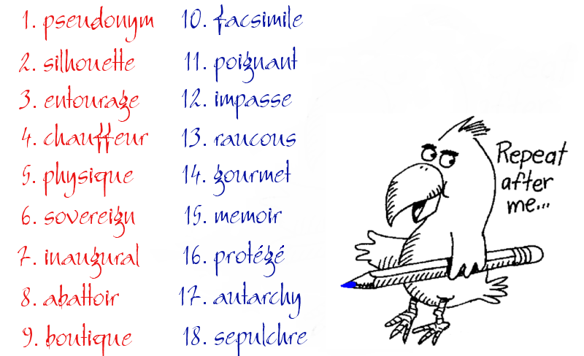

Slide 5
Today’s Class
Review: pronunciation of interview questions
Watch video: People’s vocal chords singing
Watch video: Introduction to Articulatory Phonetics
Review voiced vs. voiceless consonants
Learn phonetic symbol consonants
Practice writing words phonetically
“Pronunciation Plus:” Part 2- Consonants.
Unit 9, page 20
Unit 10, page 23

Slide 6
Review: Tongue Twisters
Sally sells seashells by the seashore.
The glum groom grew glummer.
Sneak thieves seized the skis.
Rubber baby buggy bumper.
The bear at the beach bit my bike.
I speak to my special species of spiders.
I run rarely around the railroad thinking many thoughts
about the rain.
Question: How much wood would a woodchuck chuck if a woodchuck could chuck wood?
Answer: As much wood as a woodchuck could chuck if a woodchuck could chuck wood.

Slide 7
Watch this Video:
Vocab Chords Up Close While Singing:
https://www.youtube.com/watch?v=-XGds2GAvGQ

Slide 8
Watch this Video:
Introduction to Articulatory Phonetics
https://www.youtube.com/watch?v=dfoRdKuPF9I

Slide 9
Voiced vs. Voiceless Consonants

Slide 10
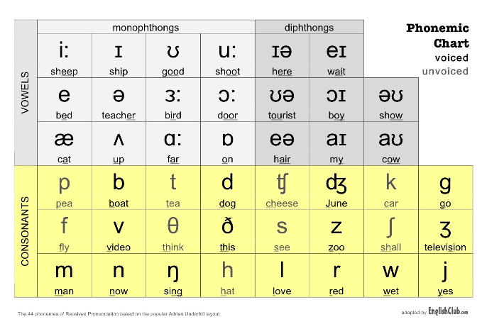
Introduction to Phonetic Symbols

Slide 11
Please Write the Following Words Using Phonetic Symbols:
Hat
Keep
Loan
Florist
Ocean
Congregation
America
Stupendous
Marriage
Stationary
Helpless
Categorical
Methodology
Figurative
Telemarketer

