Slide 1
Tackling English Pronunciation
Presented By: Amy E. Lingenfelter

Slide 2
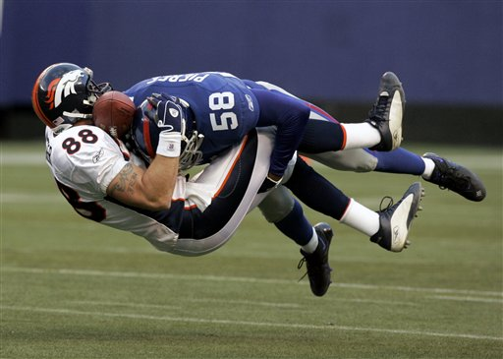
Tackling English Pronunciation

Slide 3
Overview of Course
Day/Step 1: Overview, warm up, voiced vs. voiceless consonants, phonetic symbols
Day/Step 2: Consonants
Day/Step 3: Consonant Clusters
Day/Step 4: Vowels
Day/Step 5: Vowel Clusters
Day/Step 6: Stress and Rhythm
Day/Step 7: Sounds in Connected Speech
Day/Step 8: Intonation
Day/Step 9: Sounds and Grammar
Day/Step 10: Pronouncing Written Words
Day/Step 11: Informal Speech and Idioms
Day/Step 12: Wrap up/Practice Test/Review

Slide 4
Today’s Class
Finish watching 2 videos of /r/ sound
Review all HW:
Review /w/, /y/ or /j/, /l/, /r/, and a few others
Review and practice “ED” past-tense pronunciation
Review and practice consonant clusters pgs. 40-53
Introduction to vowels:
“Phonemic Chart”
“Vowel Chart Phonics”

Slide 5
Watch These Videos:
Pronouncing “R” sound (woman):
https://www.youtube.com/watch?v=Jq_yIbrD01c
Pronouncing “R” sound (man):
https://www.youtube.com/watch?v=4wEIsyqu_Jo

Slide 6
Voiced vs. Voiceless Consonants:

Slide 7
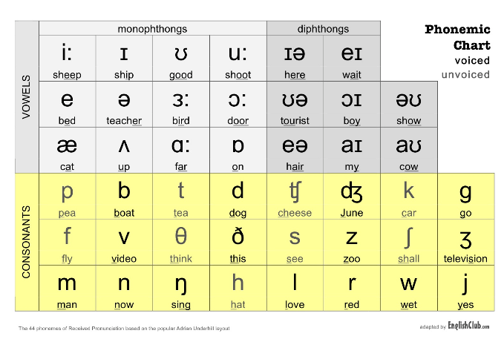
Phonetic Symbols:

Slide 8
Vowel Sounds
Phonics:

