Slide 1
Welcome to ENL Class 2017-2018!
Ms. Quinde
Grades 9-12
English as a Second/New Language

Slide 3
THIS WEEK’S TOPIC:
ALL ABOUT ME!

Slide 4
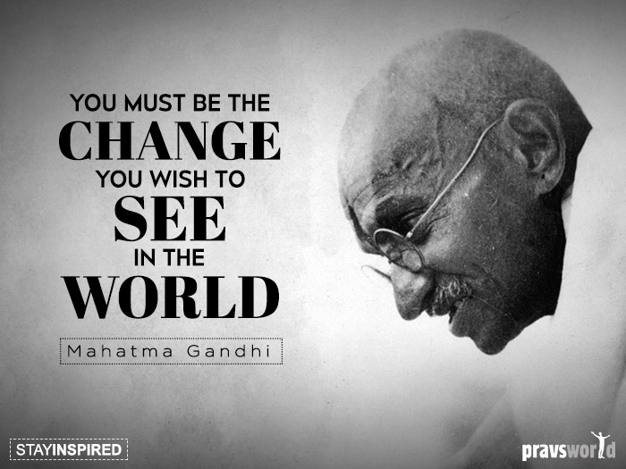
My Favorite Quotes:
“The task is…not so much to see what no one else has yet seen, but to think what nobody has yet thought, about that which everybody sees.”
-Erwin Schrodinger, 1887-1961

Slide 5
Introductions, “All About Me”
FROM MS. QUINDE’S STAR AND CHART ACTIVITY:
Question #1: Where are you from? Which languages do you speak?
Question #2: How many brothers and/or sisters do you have?
Question #3: What do you like about school? What do you hate?
Question #4: What is your favorite thing to do in your free time (hobby)?
Question #5: What are your goals for the future?
Question #6: What is one thing that most people don’t know about you?

Slide 6
All About Ms. Quinde:
My name is Ms. Quinde (pronounced “Keen-Day”). I am from the USA. I have lived in Ecuador, Japan, Spain, and Venezuela. I speak Spanish, English, and little bit of Japanese
I have 1 younger brother
I like helping students be the best they can be and working with students from different cultures and countries. I hate grading and disrespectful students.
In my free time, I like to read, paint, listen to music, and ride my bike.
My goal for the future is to open my own English language school in Ecuador.
Most people don’t know that I went sky diving.

Slide 7
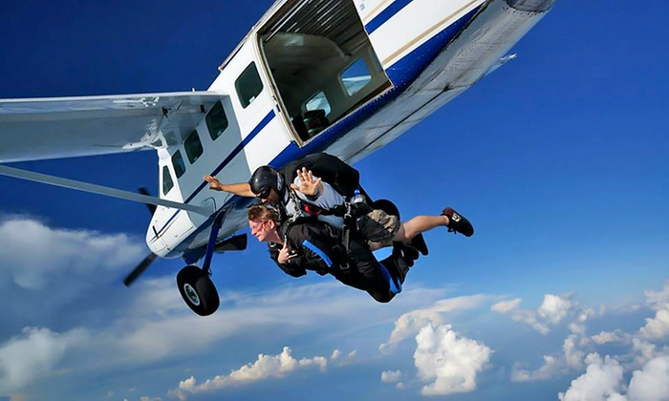
All About Ms. Quinde:

Slide 8
All About Ms. Quinde:
I have taught ESL/ENL for Buffalo Public Schools at Lafayette High School, South Park High School, and School 18. I was also a teacher in Ecuador for 5 years and Japan for 2 years.
I am married and have one son (17 months old)
ANY QUESTIONS YOU WANT TO ASK ME?

Slide 9
Rules for Ms. Quinde’s Class:
Follow Ms. Quinde’s directions the FIRST time she gives them.
RAISE YOUR HAND and wait for permission to speak at all times
When Ms. Quinde is teaching the whole class OR when one student is speaking to the whole class.
RAISE YOUR HAND for permission to leave your seat.
Keep hands, feet, objects, and eyes to YOURSELF.
Treat your teacher and classmates with RESPECT (Golden Rule).
Do your own work and do the best you can
NO CELL PHONE USE UNLESS TEACHER SAYS YOU CAN USE IT FOR TRANSLATION!

Slide 10
Introductions: “All About Me” Writing Assignment
To start:
MY NAME IS _________
I AM FROM ____________
How long have you been in the United States?
I have been in the USA for 31 years.
2) Where were you born? (Write the city and country)
I was born in Buffalo, NY, USA.
3) Where have you been before you came to the United States?
I have lived in Japan, Ecuador, Venezuela, and Spain
4) What is your native language?
My native language is English.

Slide 11
Introductions: “All About Me” Writing Assignment
Is your alphabet different from the English alphabet? Can you write it?
My language is not different from the English alphabet. / We use the English alphabet. It is the same./ It is almost the same.
OR
My language is different. My language is a little bit different. Yes, I can write it. / No, I can not write it.
6) Say and write, “my name is _______________” in your own language.
My name is Amy Elisabeth Quinde.
7) Say and write, “I am _________ years old” in your own language.
I am 36 years old.

Slide 12
Introductions: “All About Me” Writing Assignment
8) How many other languages can you speak?
I speak 3 languages. They are English, Spanish, and Japanese.
I speak 1 language. It is_________________.
Can you read and write any of those languages?
Yes, I can. I read and write English and Spanish only. OR
I can speak Japanese, but I can’t read and write it.
No, I can’t/cannot.

Slide 13
Introductions: “All About Me” Writing Assignment
10) Describe your family. Who do you live with? How many brothers and sisters do you have?
I have a loud and medium-sized family.
I have 1 younger brother and no sisters.
I have 2 older brothers and 1 sister.
I live with my husband and son.
11) What do you like to do with your family?
I like to eat dinner (verb) with my family
12) What is your favorite or special food from your country? (Please bring in a photograph or picture from the Internet).
My favorite food from my country is Wegman’s ice cream.

Slide 14
Introductions: “All About Me” Writing Assignment
What is your national or ethnic dress? (Please bring in a photograph or picture from the Internet).
In my country, our ethnic dress for men is jeans.
Our ethnic dress for women is the same.
What are your goals for the future?
(2 or more goals): My goals for the future are I want to open an English language school in Ecuador and get a cat.
(1 goals): My goal for the future is _________.

Slide 15
Introductions: “All About Me” Writing Assignment
How is Buffalo, USA different from your home country? How is it similar?
Buffalo is similar to my country because _______.
Buffalo is different from my country because _______.
Why did you leave your country and come to the USA?
I left my country and came to the USA because ______.
I left my country for _______.
Is there anything else you would like us to know about you?
(You can write anything else you want here).

Slide 16
All About Me
NAME

Slide 17
How You Can Write The Final Draft of “All About Me”
EXAMPLE OF HOW TO START YOUR PARAGRAPH:
My name is Ms. Quinde. I am from the United States. I have been in the USA for 31 years. I was born in Buffalo, NY, USA.
I have lived in Japan, Ecuador, Venezuela, and Spain
My native language is English.

Slide 18
Guidelines for Class Statistics Activity:
Topics can come from Sun Diagram activity, “All About Me” Activity, “Find Someone Who” Activity, or from your head!
You must use 15 questions/topics
You will create a statistical report about your class based on the answers to the questions about yourselves. You must show the class statistics using pie charts and bar graphs.
Groups of 3-4 students will work on specific questions and statistical information.
We will draw the information for each topic and put it on the walls inside or outside the classroom.

Slide 19
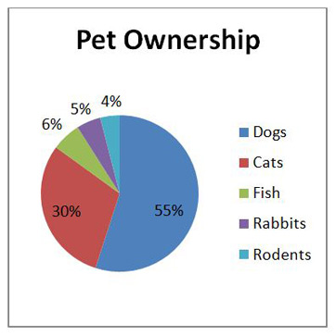
Guidelines for Class Statistics Activity:
Topics can come from Sun Diagram activity, “All About Me” Activity, “Find Someone Who” Activity, or from your head! (We will decide together)
You can make a pie chart of the information:

Slide 20
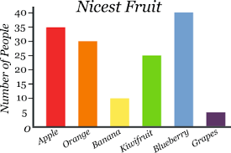
Guidelines for Class Statistics Activity:
You can make a bar graph of the information:

Slide 21
Topics for Class Statistics Activity:
MS. QUINDE’S HOMEROOM CLASS:
GROUP A:
Languages (Arabic, French, Swahili, Mai Mai, Kibembe, Spanish, Turkish, Somali, Kinyarwanda, Lingala)
Favorite foods (Bugali, Pizza, Chicken, Yahpra, Sambusa, Chakamadesu, Jegere)
How long you’ve been in the USA (mean, median, mode)
GROUP B:
Country (Syria, DRC, Puerto Rico, Guatemala, Somalia, Burundia, Tanzania, Portugal)
Favorite sport and/or favorite players (soccer, basketball, volleyball)
Age (15, 16, 17, 18, 19, 20 and/or mean, median, mode)
GROUP C:
Religion (Muslim [Shiite, Sunni], Catholic Christian, Protestant Christian, Buddhist, Hindi, Atheist, Agnostic)
Favorite color (Red, blue, white, purple, pink, green, black, brown, orange, yellow, turquoise)
How many countries have you lived in? (mean, median, mode)

Slide 22
Topics for Class Statistics Activity:
MS. QUINDE’S HOMEROOM CLASS:
GROUP D:
Favorite animal (Bird, Lion, Dog, Tiger, Zebra, Cat, Buffalo, Snake, Cheetah, Horse, Monkey, Chicken, Spider, Pigeon)
Favorite subject (Math, Social Studies, Gym, Science, English, ESL/ENL, Art, Health, Biology, Music, Algebra, Geometry, Earth Science, French, Spanish, Arabic, Swahili)
Height (mean, median, mode)
GROUP E:
Music preference/Favorite Artist (Shakira, Katy Perry, Ferre Fola, Celine Dione, Kendric Lamar, Future, Fally Ipupa, PNL, Alikiba, Adam, Diamond, Beyonce, Michael Jackson, Adele, Akaly, Ariana, Chris Brown, Akon, Baraka Da Prince, JB)
Culture/Ethnic Group: (Bembe [Congo], Mukongo [Congo] Mushies [Congo], Mai Mai [Somalia], Somali, Indigenous Puerto Ricans, Mfulero [Congo], Syrian, Iraqui, Rwanda)
Weight (mean, median, mode)

Slide 23
Topics for Class Statistics Activity:
MS. QUINDE’S HOMEROOM CLASS:
GROUP F:
Things I like about living in Buffalo/USA (Like: Winter, Downtown, Niagara Falls, Darien Lake, Beaches, Fantasy Island, Spring, Buffalo Zoo, University of Buffalo, people are respectful and nice, the teachers, houses, Disneyland, safety)
Things I hate about living in Buffalo/USA (Hate: Dogs, Winter, Swimming, the weather/climate, places are too far away/you need to get everything, racial or religious discrimination, President Trump)
Shoe Size (mean, median, mode)

Slide 24
Topics for Class Statistics Activity:
MS. QUINDE’S HOMEROOM CLASS:
GROUP G:
Number of siblings (mean, median, mode)
Environment you’re from (Rural, City, Mountains/Highlands, Beach, Tropical/Rainforest, Dry/Desert, Savannah, Temperate, Plains)
Reason you came to the USA (War, persecution due to ethnic group, insecurity, economic reasons/jobs, educational opportunities, healthcare, family, better life)

