Slide 1





Slide 2

WHILE Maximizing Student Engagement and Saving YOU Time!
  By: Amy Lingenfelter
  Senior English Language Fellow
  alingenfelter@peopleleap.com www.peopleleap.com

Slide 3
Help! There are simply too many students in my class!

Slide 4
Help: Too Many Students in my Class!
Have you ever had any of these thoughts?
I’ll never be able to teach anything in a class this big!
I won’t be able to learn all their names, so I won’t even try.
My students’ behavior will be out of control!
It’s impossible to have students work in groups and interact in a class this size.
I´m going to lose my students completely.

Slide 5
With a partner, please discuss answers to the following questions:
1. What is considered a large class size?
2. What are some common problems that teachers face when teaching a large class?
3. Guess at least 5 essential teaching strategies to succeed with a large class
4. Any conclusions you can you make about large classes?

Slide 6

Help: Too Many Students in my Class!
How do you monitor ALL students at the same time?
  Make sure they’re all on task during independent/group work?
  Monitor correct English speech if all students are talking at the same time?
  Ensure good/appropriate
  behavior?

Slide 7
Common Problems in Large Classes
2) Assessment
All feedback and grading takes more time
3) Differentiation
Difficult to attend to differences among students (learning styles, multiple intelligences, learning pace, and English levels)
Teacher can’t identify students’ flaws and there is no chance to correct every mistake
Teachers can’t dedicate time to help weaker learners
Small physical space
No materials/ resources
Lack of attention to individual issues
Cheating is prevalent
Hard to learn students’ names
Hard to maintain students’ concentra-tion and attention
1) Classroom Management
Easy to resort to multiple choice and avoid assigning large writing assignments
Bad behavior!
Not all the students have the chance to participate according to their abilities

Slide 8
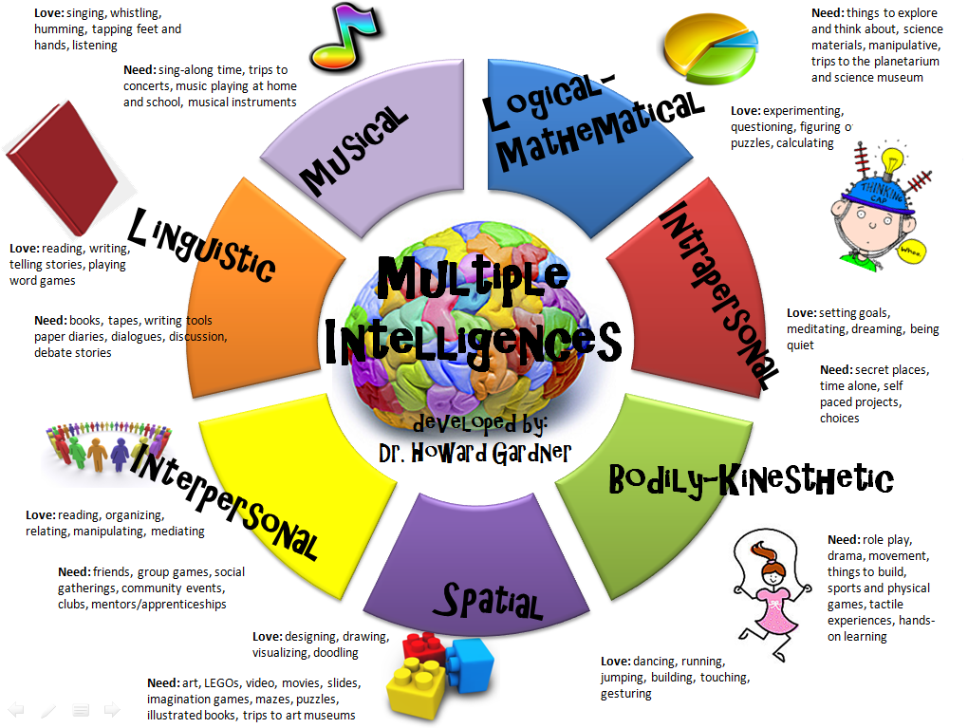
Gardner’s Theory of Multiple Intelligences (1983):

Slide 9

THREE Main Learning Styles:

Slide 10
Don’t Lose Hope: Think Positively!
Believe that your students:
Will learn in this class as much as they could in a smaller one.
Will respect each other, their teacher, and the classroom.
Will enjoy this class.
Will learn English with the materials, time, and space that exists.
Believe that as a teacher, I will be able to:
Respect individual needs and differences as much as possible and even use them to MY ADVANTAGE in the classroom!

Slide 11
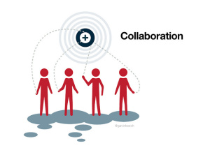
Now for some general essential strategies for teaching large classes. . .

Slide 12

GENERAL Strategies
DO USE...
Routines and structure
“Butterfly teacher” method
Random student selections
Random grading and collecting
Student note-taking/recording and/or reporting about what a classmate said
Time limits and rewards to motivate and keep students on task

Slide 13
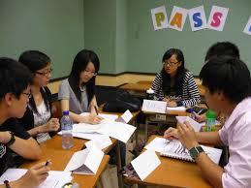
GENERAL Strategies
Make sure students are:
  Constantly DOING something (engaged)
  Can prove that they’re working at all times
  Are responsible for their own work
  Acting as helpers, “teachers,” and the main “workers” of the classroom!

Slide 14
GENERAL Strategies
Students must practice speaking everything they learn as much as possible
Grouping: use mingling, pair, and group work often!
    Requires students to constantly talk
  Group students strategically based on mixed abilities and social relationships
  Within a group, give each student a role for which they must be held accountable
  Assign students ongoing roles as team leaders/partners/”buddies” of others

Slide 15
Using structured groups will
“keep students in check”. . .

Slide 16
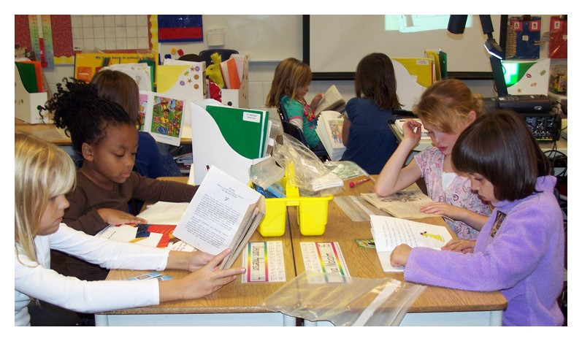
Using Structured Groups
A structured group is an organized team with a task allocation for every member.
The teacher supervises each group “butterfly style” while it works to achieve a common goal.

Slide 17
Using Structured Groups
Working in groups allows:
        More time for conversation practice, without a teacher’s continuous monitoring
        Students to manage both themselves and their group members:
            Individual vs. group accountability- both are key!
        Students to teach each other
          Better support for struggling students

Slide 18
Example: Using Structured Groups

Slide 19
Establishing classroom routines & procedures will create “order from chaos”. . .

Slide 20
Classroom Routines & Procedures
        Routines enable students to:
          Work with less specific guidance
          Work more independently
        Routines should be:
          Predictable and automatic
          Organized ahead of time
        Teachers should:
          Dedicate time to establishing routines in the first month of school
          Write all rules/procedures down

Slide 21
Classroom Routines & Procedures
Teachers should:
          Establish explicit procedures for how students should behave in each class activity
          Periodically and randomly check students’ self-managed materials
          Emphasize the objective and steps of instruction at the beginning of every class
          Use introduction of routines & procedures to teach language points

Slide 22
Example: Classroom Procedures

Slide 23
Example: Group Procedures

Slide 24
Positive behavior management strategies create positive results every time. . .

Slide 25
Positive Behavior Management
Create a “good behavior” culture in the classroom
Make sure you explicitly distinguish between “good” and “bad” behavior
Make expectations more positive
Use positive reinforcement more often than negative reinforcement (punishment)
          Offer/praise “replacement behaviors”
Praise/offer rewards for “good behavior” for others to imitate

Slide 26
Positive Behavior Management
Make consequences of unacceptable behavior very clear and follow through on them
Be consistent: respond to the same type of behavior in the same way!
Let problem students help out and feel “special”
Have students create their own rules as a class that the teacher approves

Slide 27
Positive Behavior Management
If possible, post in the classroom or hand out the “5 Classroom Management Essentials,” in a positive tone:
  Expectations
  Rules
  Consequences
  Rewards
  Routines/Procedures
They can also be used in a language lesson

Slide 28
Example: Positive behavior Management

Slide 29
Example: Positive behavior Management

Slide 30
Example: Rewards

Slide 31
Help! I have to grade 250 assignments!. . .

Slide 32
1. Efficiency strategies for assessing writing:
The most time-consuming assessment of all!

Slide 33
Efficient Assessment of Writing:
Do you Agree or disagree?
In pairs or groups of 3, please discuss:
It’s impossible to assign writing assignments larger than a few sentences in large classes
You should correct every single error in every single assignment
Peer and self editing saves the teacher time and helps the students
Writing rubrics are difficult to use
You should collect and grade every writing assignment

Slide 34
Strategies for Teaching/Grading Writing in Large Classes
Assign shorter but more frequent writing assignments with targeted grammar or other language points
  Focus on one grammar/language point only per assignment
DO USE:
  Self and peer-editing
  Pre-writing graphic organizers
  Writing rubrics

Slide 35
Example: Efficient Teacher Assessment

Slide 36
Example: Efficient Teacher Assessment

Slide 37
Example: Efficient Teacher Assessment

Slide 38
Strategies for Teaching/Grading Writing in Large Classes
100% random collection of work
Jigsaw writing/”story chain”
Provide model examples
Provide non-model (opposite) example
Teach “Words Never to Use in Formal Writing”
Writing “error deduction” method for things students are expected to know

Slide 39
Model Paragraph (Full)
I am a student at ABC High school. I want to be a soccer player when I grow up because I like to compete and move my body. I think a soccer player is a good profession for me because I am very athletic and cooperative and play well in teams. However, sometimes I want to be a politician because I want to change my country. I think I would be a good politician because I am hard-working, friendly, logical, and confident. Although many real politicians are not compassionate, I will be one of the few!
When I was a child, I played in a soccer league with children who were older and stronger. However, I was very brave, and I learned a lot because I wasn’t cautious. Our team won the championship that year.

Slide 40

Model Paragraph (Full)
In my first year of high school, I was the student leader of my class. There were also two other leaders and we worked together. We were all decisive and organized, so we made a lot of good changes in the school. This experience gave me skills to be a confident politician in my country, Ecuador, when I grow up.
I hope that my dream comes true someday.
Now, can you guess who I am?

Slide 41
Model Paragraph (Stuctured)
I (be) a student at _________. I want to be a _________ when I grow up because I like to _________ and _________. I think a _________is a good profession for me because I (be) very _________ and _________. However, sometimes I want to be a _________ because I want to _________. I think I would be a good _________ because I (be) ________, ________, and _______.
When I (be) a child, I _________. In my first year of high school, I (be) _________. There (be) _________. We (be) _________. This experience gave me skills to be a _________ _________ when I grow up.
I hope that my dream comes true someday. Now, can you guess who I am?

Slide 42
Example: Efficient Teacher Assessment

Slide 43
2. Peer and self-assessment: Hallelujah!!

Slide 44

Peer and Self-Assessment
It doesn’t mean students grade each other instead of the teacher
Works best for topics that students are already expected to know
Students learn from their peers and while they’re assessing others

Slide 45
Peer and Self-Assessment
Students use checklists/graphic organizers with peers or self
For multiple-choice assignments students can grade each other
In the end, the teacher corrects work that has already been revised by students

Slide 46
Example: Peer and Self-Assessment

Slide 47
Example: Peer and Self-Assessment

Slide 48
Example: Peer and Self-Assessment

Slide 49
3. They’re all talking at the same time!
Teaching and grading speaking & listening. . .

Slide 50
Strategies for Teaching/Grading Conversation In Large Classes
Class should be student-centered: students should be talking more than the teacher!
  75/25 rule
Nobody likes waiting their turn to speak!
Students should practice speaking in pairs or groups about everything they are learning

Slide 51
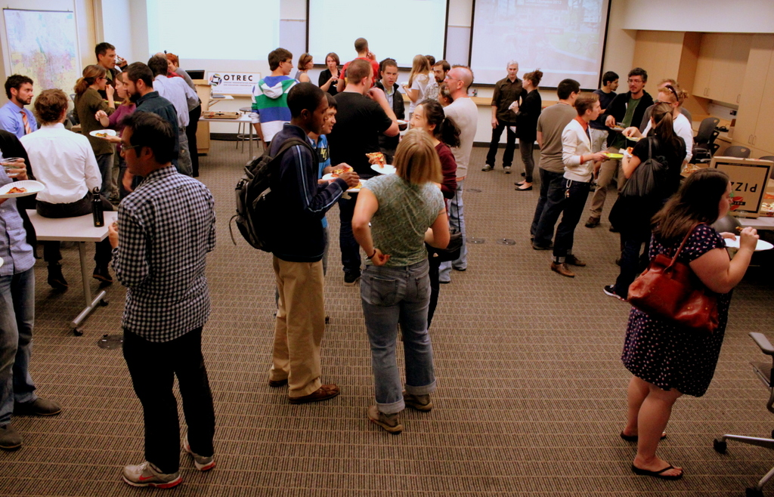
Strategies for Teaching/Grading Conversation In Large Classes
  Speaking & listening “maximization” strategies:
  Take turns speaking in groups
  Write down/report what was heard
  Mingling
  Inner/outer circle
  Line pairing
  Debating
  AA + BB =
  ABAB

Slide 52
Example: Mingling Chart
Partner’s Name | Time of Day | Daily Routine
Maria Jose | Afternoon | She does her homework
Jonathan | 6:30 am | He brushes his teeth
Notes:
m

Slide 53
Example: Debate Topics
  Debate/Agree-Disagree Topics:”
What should the legal drinking age be?
Do you believe in aliens/extraterrestrial life forms?
Can people from different cultures/countries have a good relationship?
Is it important to speak more than one language? Which is the most important language to know?
Do you think violence should be eliminated from movies?
Should all education be free? Why or why not?
Do you think that men should take a more active role in household responsibilities (e.g. cooking, taking care of children, cleaning, etc.)?
If I didn’t have to worry about money but still needed a job, which job would I pick?
Should governments provide financial support to people?

Slide 54
Strategies for Teaching/Grading Conversation In Large Classes
  Speaking & listening “maximization” strategies:
  Pull topics out of a “hat”
  Alternative assignments for fast and/or bored students
  Board games: can be used to practice almost anything!
    Have the students create their own questions on cards first

Slide 55
Example: Conversation board game

Slide 56
Example: board game template

Slide 57
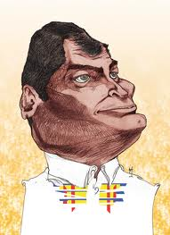
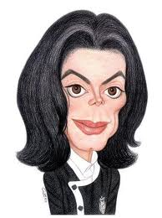

Strategies for Teaching/Grading Conversation In Large Classes
  Speaking & listening “maximization” games:
  English relay race (speak and/or write)
  Blind picture description
  Pictionary
  Charades
  Running dictation game
  Broken telephone

Slide 58
Strategies for Teaching/Grading Conversation In Large Classes
For listening: activities that require note-taking and “recording charts” that the teacher collects:”
  Videos/movies
  Song activities
  If available: individualized audio aids and any internet learning activites:
    For more info, please visit this link: http://peopleleap.com/resources/links/

Slide 60
Strategies for Teaching/Grading Conversation In Large Classes
Suggestions for the teacher:
Teacher (or CD) should always model pronunciation first
Don’t grade “on-the-spot” speaking, ONLY formal (final) presentations
You can choose to collect and/or grade note-taking assignments

Slide 61
4. Now for getting students to actually READ. . .

Slide 62
Strategies for Teaching/Grading Reading In Large Classes
General strategies:
  For longer texts: alternate between students reading outloud to each other in pairs, groups, and silently
    Try to avoid whole class reading where one student reads outloud
    Nobody likes waiting their turn to read!
  Teacher (or CD) should read text outloud first to model pronunciation

Slide 63
Strategies for Teaching/Grading Reading In Large Classes
General strategies:
  Require students to underline and/or record specific details in text
  Assign reading for homework with in-class assessment next class

Slide 64
Strategies for Teaching/Grading Reading In Large Classes
Reading activities/games:
  Jigsaw reading activities
  Read-pair/group-share
    Summarizing
    Paraphrasing
  Running dictation game
  Songs as a way of reading poetry
  Total Physical Response for details in text

Slide 65
Example: Cough when you hear/read the simple past tense:
Born on 29th, August 1958, this talented person started his entertainment career as the lead singer of a famous group. The band was made up of his brothers who were all older than him, and was run by his father Joseph. The group did very well and the star of the band was undoubtedly this person at only eleven years of age!
He started singing solo two years later and pioneered the entry of African Americans into the world of pop music. Many different types of people around the world started following his creative music, which gave him instant success. His fans numbered in the millions even though he was just in his teens.

Slide 66
In-Class Example:
What are some other ways we can group our students for speaking in this activity?
Topic: “Teaching Daily Routines”
Strategy: AA + BB = ABAB
  Question: What do you do in the (afternoon)/at (8:00 am)?
  Answer: I (do my homework)
Discuss question/answer with a partner
Get into groups of 4s (combine two pairs)
Pairs share their partner’s response with the other pair until all have shared
Each student records partner or groupmates’ answers
Lastly, a few students can share what they’ve learned with the whole class
Notes:
m

Slide 67
Example: Mingling Chart
Partner’s Name | Time of Day | Daily Routine
Maria Jose | Afternoon | She does her homework
Jonathan | 6:30 am | He brushes his teeth
Notes:
m

Slide 68
Next Presentation:
Presenter: Vicky Holdridge:
  Former Senior English Language Fellow in Peru
  English textbook author
  (Time: 1:11-33:00)
Notes:
m

Slide 69

Now for you to put your skills to the test!
Drum roll please. . .

Slide 70
Your Practice Task:
  Find ONE language point/assignment in “Postcards” or other textbook
  Think of at least ONE way you could change that activity to make it work for a large class AND maximize student participation and talking time
  Prepare a 5-minute mini-lesson using the strategies learned today and write the procedures on large paper
  Be ready to “teach” this mini-lesson and later justify why you chose this activity to your large group of peers!
Notes:
m

Slide 71
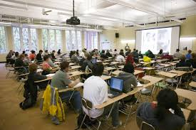
References
  “Essential Strategies for Teaching Large Classes” -by Brock Brady

Slide 72
References
  “Student-Centered Teaching in Large Classes with Limited Resoures” –by Susan Renaud, Elizabeth Tannenbaum, & Phillip Stantial

Slide 73
Thank you!
Questions? Comments?

Slide 74
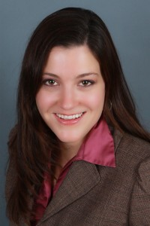
My Contact Info:
My website: www.peopleleap.com
    Go to “Resources” and “Amy’s Professional Blog”
My email: alingenfelter@peopleleap.com
Shaping the Way We Teach English Website: http://oelp.uoregon.edu/shaping
American English Website: http://americanenglish.state.gov
MOE Resources: http://educacion.gob.ec/documentos-pedagogicos/

Slide 75






