Slide 1

Developing Activities
David Murphy
English Language Fellow
ELFPachuca@Gmail.com
www.comexus.org.mx

Slide 2
Presentation Structure
The structure of this presentation consists of two parts:
Theory behind Activities Development
Games and Activities for Developing Activities

Slide 3
Characteristics of a Lesson and
Sequencing of Activity Design
A lesson should be three things: memorable, useful, and entertaining.
Sequence your lessons logically: determine what you want your students to learn, then design activities that are measurable and help your students reach that outcome.

Slide 4
Identify Your Outcomes
Research shows that learners retain information more completely when they know that they are working towards a goal
Tell your students what you expect them to be able to do by the end of the class
Stating the learning objectives helps you guide your lesson effectively.

Slide 5

Signpost Your Outcomes
Tell your learners what you will discuss next.
Remind your students how the next point will relate to the student learning outcomes.

Slide 6
What are Multiple Intelligences?
“Intelligences,” as used here, refer to the different ways that people learn.

Slide 7
Educational Theory
According to Howard Gardner:
There are many ways to learn efficiently, and these ways are called “intelligences”.
Education is not fixed, thus it can be developed.
For mental functions to be defined as an intelligence, they must include:
Skills enabling individuals to resolve problems.
The ability to create an effective product.
The potential for finding or creating problems.

Slide 8
Dr. Howard Gardner identified eight “intelligences”
Bodily-kinesthetic intelligence
Interpersonal intelligence
Intrapersonal intelligence
Linguistic intelligence
Logical-mathematical intelligence
Musical intelligence
Spatial intelligence
Naturalist intelligence

Slide 9
Bodily/Kinesthetic
“Movement smart”

Slide 10
Naturalist
“Environmentally smart”

Slide 11
Intrapersonal
“Self smart”

Slide 12
Interpersonal
“People smart”

Slide 13

Linguistic/Verbal
“Word smart”

Slide 14
Logical/Mathematical
“Number/Reasoning smart”
?

Slide 15
✵
✵
Musical 
“Music smart”
✵

Slide 16
Visual/Spatial
“Picture Smart”

Slide 17
Communication Gaps & Retention
Communication gaps – what is clear to you is not always clear to the students
  Although lessons are student centered, one job which the teacher retains is to verify that students are understanding what you say.
  Ask students, “What is this activity about? Why are we doing it? What is the object of today´s lesson?”
Retention – students are often unable to remember what happened at the beginning of the class. Ask them frequently to recap main ideas and what they learned.

Slide 18
Organize Your Activity to be Efficient
Ensure that your activity is student centered.
Activities should efficiently use the time that you have.
Address multiple intelligences during your lessons.
Develop your activities to include the 4 skills and grammar.

Slide 19
How can you develop this activity to include the four skills?
“Who Am I”
Students all create an identity card.
Then, everyone mingles. Each person finds a partner. They may ask their partner 3 Yes or No questions in order to guess their identity.
If they can’t guess, they change partners and try again.

Slide 20
Creating Lesson Plans
Identify your student learning outcomes.
Outline your activities.
Review your activities and look for ways to make them more student-centered, to appeal to some of the eight intelligences, and to treat the four skills plus grammar.

Slide 21
Evaluate lesson plans
Does the lesson plan include:
Activities that appeal to at least 3 different intelligences? Which ones?
Does the lesson meet its objectives? (Look at the evaluation task and student learning outcomes.)
Is the lesson plan appropriate for the level of the students?
Is the activity as student centered as it can possibly be?
Have you included the four skills plus grammar?

Slide 22
Managing Large Classes
Use a Variety of Teaching Techniques
Break Lectures into Smaller Chunks
Change Poor Student Behavior by Focusing on Learning Styles and Playing English Language Learning Games

Slide 23
Managing Large Classes
Emphasize that regular use of Spanish means that learning English will be slower and that students will miss valuable opportunities to use English in authentic situations
Using pair work helps to get quiet students talking as they are under less pressure in small groups
The age and background of students needs to be taken into account when choosing an activity
Teachers can gently deflect answers from stronger students and give time to other members of the class by saying, "Thank you, what about this side? Do you have any ideas?"

Slide 24
Managing Activities
It may be easier to manage large classes during activities if:
students and the teacher define the activity’s rules together at the beginning
the teacher is consistent in applying the rules and doesn't show favoritism to some students
the teacher rewards good behavior by simple praise or with a smiley face sticker
the pace of the game keeps moving even if some students are misbehaving so that they miss out but the rest of the class does not
noisy games are followed by quiet games

Slide 25
Activities
Disappearing dialogues – write a line on the board, the class repeats it, then you erase parts of the line.
Dialogue building – use a drawing of stick figures to create a scene. Students write the dialogue for the scene.
Information gap activities – information to complete a task is distributed among students. The students must share the information to complete the task.

Slide 26
Taboo
Put students into groups. One of the students must sit with their back to the board, the other students facing the board.
The teacher draws a picture or puts a flashcard on the board. The students have to describe what is on the board to help the student (with their back to the board) to guess what it is.
For higher level students write a number of TABOO WORDS on the board. For example if a teacher shows the students a flash card of say ‘a teacher’, the taboo words that students cannot say could be ‘school’ and ‘student’.

Slide 27
The Hot Air Balloon Game
Every student chooses to be a famous person or fictional character.
In groups, the students discuss a scenario in which they must choose a person to throw out of a sinking hot air balloon, so that the other people can be saved.
Students must discuss their own attributes and others’ weaknesses.
This is a good activity to use with descriptive adjectives and comparatives/superlatives.

Slide 28
Drawing Descriptions
Students each get a single picture, and they must describe to their neighbor what the picture looks like.
Students who are listening must draw the picture.
After the first student is finished drawing, the first student should describe a different picture to the second student.

Slide 29
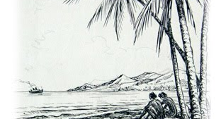
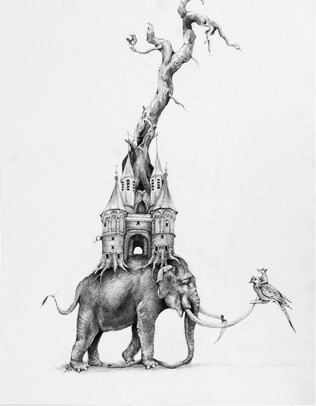
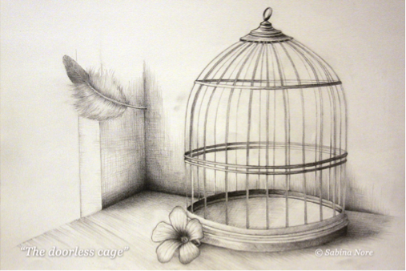
Drawing Examples

Slide 30
How Can You Develop the Describing/Drawing Activity to Include the Four Skills Plus Grammar?
“What skills are being used?”
“What skills are missing?”
“How can I incorporate the missing skills?”
Discuss these questions in groups.
Write three solutions.

Slide 31
The Marketplace
Bring authentic materials to class when your students are learning vocabulary
Set a desk up as a market and use paper money for students to buy/sell the fruits, vegetables, or clothes.

Slide 32
Reading
Use Spanish literature or English literature in your classrooms.
Ask students to translate the Spanish literature into English.
Ask students to read the English literature.
Develop this activity so that students will speak and listen—you can dictate the texts or ask students to summarize the texts in writing.
Use proficiency appropriate texts.

Slide 33
Hold It Up!
When the students are in groups, say one of the vocabulary words that you want to review (or give a definition for higher levels).
One team member must write the word on their paper and hold it up.
The student to hold it up first gets one point for their team.
After five vocabulary words, change the team member who must write.
Variation: Students who haven't learned the alphabet can be given pictures to hold up.

Slide 34
Jeopardy!
Before class begins, create a list of questions and answers that relate to previous lessons.
Create 5 topics and 5 questions for each topic with different levels of difficulty, then assign points to each of those questions.
Divide students into teams, and take turns letting teams choose the topic and the point number.
Ask each team the question that goes with their selection.
If the team gets it right, they get the points. If they are wrong, then the question is put before everyone.

Slide 35
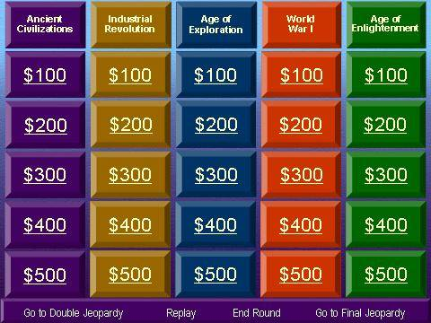
Jeopardy Example

Slide 36
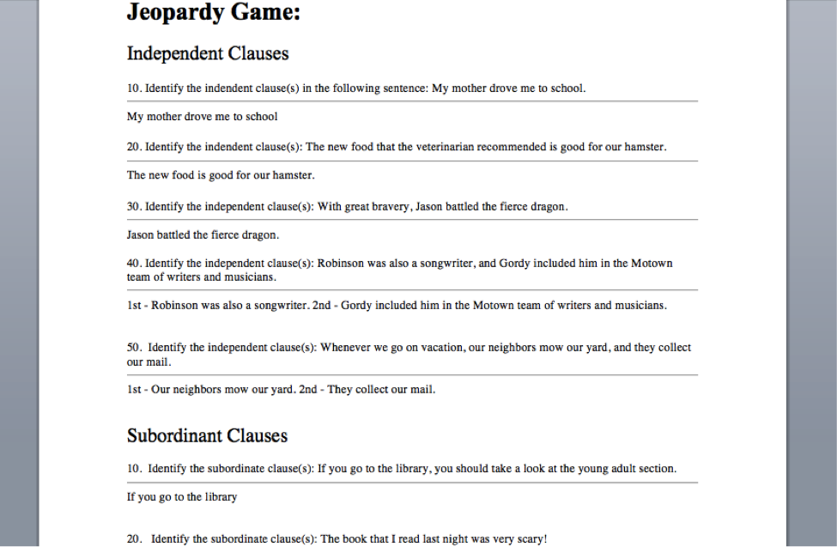
Jeopardy Sample Questions

Slide 37
Guess Who?
Each student in a group chooses a famous person or thing.
Group members ask yes/no questions about the famous person or thing.
When a group member receives a 'yes' to their question, they can ask one follow up question
If the answer to a group member's question is no, the next student gets to ask a question
You may choose to prepare a handout of possible questions to get things started and help weaker students. Some possible questions are: ‘Are you famous?’ ‘Are you a man?’ ‘Are you a woman?’ ‘Are you an actor?’ ‘Are you a singer?’

Slide 38
More Activities
Surveys – students survey one another. They can create their own surveys too.
Blocking games – when a routine is occurring, but one of the people does not follow the routine. The situation must be negotiated.
Show and tell – every day, a different student brings something to class to talk about.

Slide 39
More Activities
The Soap Opera – Each student takes the role of a character in a Mexican soap opera. They then write scripts and enact the soap opera. Or, students create their own soap operas in groups, and each soap opera is judged by the teacher.

Slide 40
1
3
1
2
2
5
3
4
6
7
8
4
5
top
January
February
March
April
May
6. June
July
August
September
October
November
12. December
left
right
1
2
3
4
5
7
Bottom
6
8
9

Slide 41
Thanks!
David Murphy
English Language Fellow
ELFPachuca@Gmail.com
www.comexus.org.mx
Toluca, Mexico

