Slide 2
Teaching English Language Learners (ELLs) in a Mainstream Classroom Environment
Presented by: Amy Lingenfelter

Slide 3
What exactly IS an English Language Learner (ELL) in an academic context?

Slide 4
Definition of an ELL:
A student who is receiving academic instruction in English when English is not the primary language spoken at home, AND
A student who is considered to be below grade level in one or more of the 4 primary language skills (listening, reading, writing, and speaking) due to not having yet received enough exposure to or instruction in English.
REMEMBER: most of your students are not frequently using or hearing English outside of school- for every less hour they use it outside school, they need school time to catch up!

Slide 5
Discuss with a partner: True or False?

Slide 6
Students’ ability to speak and understand a second language is a good reflection of their ability to read and write in that language.
Students reach academic proficiency in a second language within 2-3 years.
Younger students learn a second language faster than adults.
It is very difficult to lose your accent in a second language if you start learning it after puberty.
Pull-out English classes are usually more effective than push-in.

Slide 7
Answers:
1-2. FALSE. Don’t confuse spoken/conversational proficiency with academic proficiency. Basic conversational skills are acquired in around 2-3 years, while academic proficiency takes 4 to 7 years to acquire!
3. FALSE. Younger students don’t necessarily learn a second language faster than adults. It’s just easier to pick up the simpler language and simpler cognitive tasks that are geared toward younger students to begin with.

Slide 8
4. TRUE. The younger the students are when they acquire a second language, the less likely they are to have an accent. If they start learning after puberty, there is a strong chance that they will always have a slight accent.
5. FALSE. Pull-out and push-in language instruction can both be equally effective, given the right strategies and resources!

Slide 9
More General “Truths”
to Keep in Mind:
An ELL should be able to understand roughly 80% of the words in a sentence or text in order to generally comprehend the meaning.
Students crave and learn language through meaning and context, not isolated rules or labels:
Teach language topics by connecting them to real-life meaning.

Slide 10
More General “Truths”
to Keep in Mind:
Use the same strategies you use to teach reading/writing skills and comprehension with native speakers, but more often and more explicitly.
REMEMBER: Strategies that benefit ELLs benefit ALL STUDENTS!

Slide 11
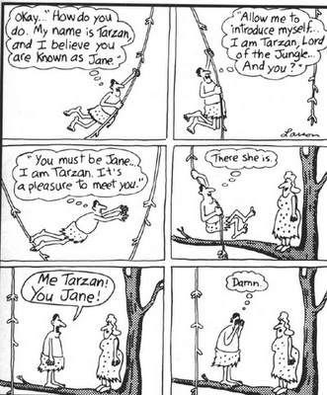
Content vs. Skills in English:

Slide 12
Content vs. Skills in English:
CONTENT/KNOWLEDGE | SKILLS
THE INFORMATION YOU ARE TEACHING (KNOWLEDGE AND FACTS) The WHAT DEFINING things and terms Background knowledge of the topic students are reading and writing about (e.g. “Mother Theresa”) ________________________________ Cultural knowledge and awareness of English-speaking countries Knowledge of English, including: Grammar rules Meanings and correct uses of vocabulary words, transition words, expressions, idioms, etc. Labeling the components of a paragraph or essay Different genres of reading Knowledge of informal vs. formal language | THE ABILITIES, METHODS, APPROACHES, AND STRATEGIES YOU ARE TEACHING The HOW (to apply your knowledge) ________________________________ Writing skills How to organize an essay/paragraph How to write an introduction, paragraph, and conclusion How to write a topic and concluding sentence How to use vocabulary in context of a sentence How to apply the grammar rules in a sentence How and when to use informal and formal language in writing Listening skills Note –taking Understanding pronunciation and intonation

Slide 13
Content vs. Skills in English:
CONTENT/KNOWLEDGE | SKILLS
THE INFORMATION YOU ARE TEACHING (KNOWLEDGE AND FACTS) Teaching WHAT and DEFINING things Background knowledge of the topic students are reading and writing about (e.g. “Mother Theresa”) ________________________________ Knowledge of English, including: History of English and etymology Linguistics Physical structure of mouth/throat during pronunciation Definition of skimming and scanning Difference between academic/formal and casual/informal written and spoken language | THE ABILITIES, METHODS, APPROACHES, AND STRATEGIES YOU ARE TEACHING Teaching HOW to DO something and APPLY your knowledge ________________________________ Reading skills Skimming/Scanning How to guess unknown vocabulary in context Predicting and using background knowledge Speaking skills Group speaking strategies Pronunciation and intonation strategies How to use words and phrases in a conversation in the right context How and when to use formal and informal language in speaking How to speak politely

Slide 14
Now please do what I say:

Slide 15
Baba lulu gaga jeje shan gloglo hihi!

Slide 16
Baba lulu gaga jeje shan gloglo hihi!
Open book the you 5 page now!
Baba = Open
Gaga = article (like “the/a”)
Lulu = Book
Jeje = You
Shan = 5
Gloglo = page
Hihi = now, in this/that moment
Task: Please write each word in your vocabulary notebooks and draw a picture of the word that helps you remember its meaning.

Slide 19
Now read this (and do this when you read the word “nanao”):

Slide 20
Jenny babava lulu her and saw on shan gloglo wuwu gaga of a naonao.
The naonao made her ververva. Hihi she started crying ververfofo.
After that, Jenny didn’t want to fadifadi the lulu anymore. She maymayva the lulu and yoyova it on the quiqui.
Jenny’s teacher sarsarva her for maymay the lulu. She made her baba shan gloglo again, but Jenny still ververva from the nanao.

Slide 21
Jenny babava (open) lulu (book) her and saw on shan (5) gloglo (page) wuwu gaga (a/the) of a naonao.
The naonao made her ververva. Hihi (now/in this moment) she started crying ververfofo.
After that, Jenny didn’t want to fadifadi the lulu (book) anymore. She maymayva the lulu (book) and yoyova it on the quiqui.
Jenny’s teacher sarsarva her for maymay the lulu (book). She made her baba shan gloglo (open page 5) again, but Jenny still was ververva from the nanao.

Slide 22
Discuss with a partner: what do you think these words mean based on the context?

Slide 23
Wuwu = ?
Naonao = ?
Verver = ?
Fofo = ?
Va = ?
Maymay = ?
Fadifadi = ?
Yoyo = ?
Quiqui = ?
Sarsar = ?

Slide 24
Wuwu = image/photo/picture
Naonao = ghost
Verver = scared
Va = past tense/adjective marker (like “ed”)
Maymay = close
Fadifadi = read
Yoyo = throw/hurl/destroy
Quiqui = floor
Sarsar = scold/yell

Slide 25
Jenny open book her and saw on 5 page image the of a ghost.
The ghost made her scared/fearful. At this point, she started crying ververfofo.
After that, Jenny didn’t want to read the book anymore. She closed the book and threw it on the floor.
Jenny’s teacher scolded her for close the book. She made her open page 5 again, but Jenny still was still scared from the ghost.

Slide 26
Now let’s do Jigsaw Reading (pairs with pairs). . .

Slide 27
Discuss with a partner: what do you think “fofo” means?

Slide 28
Wuwu = image/photo/picture
Naonao = ghost
Verver = sad/scared
Fofo = adverb marker (like “ly”)
Va = past tense/adjective marker (like “ed”)
Maymay = close
Fadifadi = read
Yoyo = throw/hurl/destroy
Quiqui = floor
Sarsar = scold/yell

Slide 29
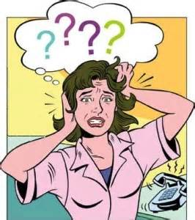
So: what did I do to make you understand this gibberish?

Slide 30
Gestured/used exaggerated body language and facial expressions
Exaggerated intonation
Repetition, repetition, repetition: Repeated the same language several times in the same way
Pointed to the difficult words as I read them out loud and objects I was referring to
Used graphic organizers
Drew a picture of the word and had you do the same
Used Total Physical Response (TPR) for un-known words that were related to the meaning

Slide 31
Explicitly had you infer meaning from context
Used guessing activities
Modeled reading outloud first, then had you do pair outloud reading
Did strategic pairing based on level/knowledge
Modeled how to do the activity with student volunteers
Did Jigsaw reading based on level/knowledge
Did “Think-Pair-Share”
Used communicative, student-centered strategies
Explained grammar in context through patterns

Slide 32
General Tips for ELL Beginners:
Pair student with a buddy who speaks her native language and/or is a stronger student (academically or English-wise).
Don’t discourage a student from speaking or writing in their native language, especially if she is a beginner- just require that she finds a way to also express it in English either by:
Repeating/copying you (your paraphrase)
Figuring out a different way to say it, or
Using a bilingual dictionary

Slide 33
General Tips for all ELLs:
Label as much as you can in the classroom (e.g. doors, windows, plants, etc.).
“A picture is worth a thousand words:” Use visuals as much as possible to explain a concept with extensive modeling (charts, graphs, graphic organizers, photos, drawings, etc.).
Allow students to draw/illustrate what they want to express but can’t communicate as well verbally, then show them how to describe their illustration in spoken and/or written words. Drawings can also be used as a way of brainstorming and pre-writing.

Slide 34
General Tips for all ELLs:
Explicitly teach the difference between spoken (informal) and written (formal) English.
Focus more on language use and less on language labels/rules.
Allow for greater repetition of new words, concepts, and items that are both spoken and written down, etc. Repetition is key to language learning!

Slide 35
When Teaching Writing to ELLs:
Encourage frequent low-risk free writing in English.
Allow students to practice writing down what they hear (dictation).
Allow them to use higher-frequency vocabulary to write complex topics.
Encourage process writing and Writer’s Workshops in which revisions and one-on-one discussions about writing are frequent.
Employ peer-editing and self-editing as often as possible.

Slide 37
When Speaking to ELLs:
Make a point to speak more slowly than normal and enunciate each word clearly.
Use exaggerated animated facial expressions and gestures to support/illustrate a concept, object, or feeling.
Exaggerate intonation of words when speaking.
Use consistent vocabulary (say something in exactly the same way until it is comprehended), especially for daily routines and directions.
Model standard spoken language and correct spoken errors by paraphrasing.

Slide 38
When Teaching Vocabulary to ELLs:
Assign students a vocabulary notebook in which they record words they read or hear, and then write their definitions/synonyms, illustrations, and/or translations.
Use T.P.R. (Total Physical Response) to teach a concept/word.
Teach grammar and lower-frequency (“Tier 2-3”) vocabulary explicitly using text from all subject/content areas.
Use high-frequency words in speaking and texts first, then scaffold to lower frequency words.

Slide 39
When Teaching Reading to ELLs:
Write down and point to every word as you/the student presents it/reads it aloud.
Before reading, build tons of background knowledge about both content and Tier 2 and 3 vocabulary words.
Whenever possible, adjust/simplify text to students’ level of comprehension.

Slide 40
Specific Accommodations for ELLs:
Whenever possible, allow the questions themselves on assessments to be worded as simply as possible.
Allow students more time to process information and thoughts before production (speaking, writing), and more time to speak.
Allow students more time to complete assignments (time and a half or more), especially exams and longer written assignments.

Slide 41
Connection to Home Language
And Culture for ELLs:
Require that Beginning and Intermediate ELLs have and use a bilingual dictionary in their first language.
Encourage students to make connections to their native language and home country/culture whenever possible.
If students are literate in Spanish, emphasize the inconsistency of English. Drill sight words more often with these students.

Slide 42
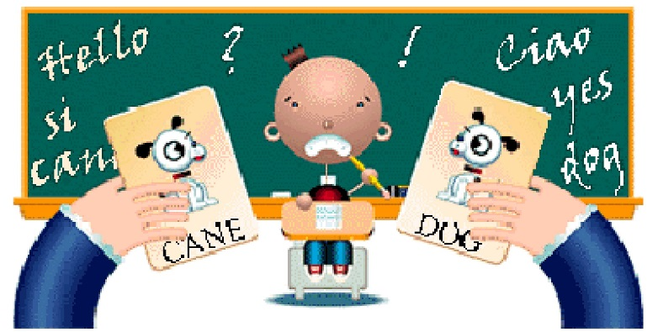
Connection to Home Language
And Culture for ELLs:
If Spanish is their first language, emphasize and explicitly teach cognates and false cognates.
Don’t discourage a student from speaking or writing in her native language, especially if she is a beginner- just require that she finds a way to also express in English either by:
Repeating/copying you
Figuring out a different way to say it, or
Using a bilingual dictionary

Slide 43
Grouping/Classroom Management:
Allow students to share ideas orally with partners (especially friends) and/or small groups before or instead of sharing with the whole class.
Pair/group students heterogeneously (i.e. more proficient students with those who are less proficient).
Seat less proficient students in the middle of the classroom so they can be most aware of what others are doing.

Slide 44
My website: www.peopleleap.com

Slide 45
Thank you! Questions? Comments?

Slide 46
