Slide 1
Welcome to ENL Class 2017-2018!
Ms. Quinde
Grades 9-12
English as a Second/New Language

Slide 3
THIS WEEK’S TOPIC:
ALL ABOUT ME!

Slide 4
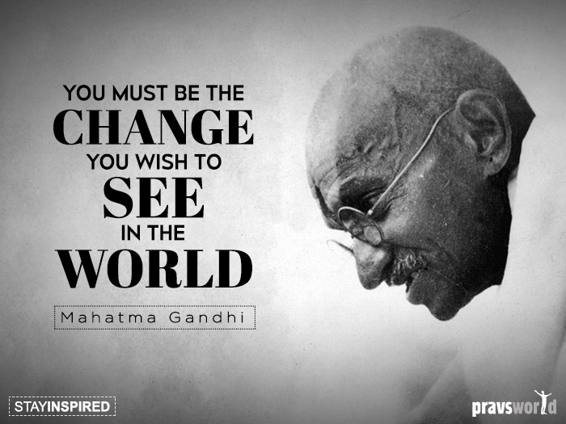
My Favorite Quotes:
“The task is…not so much to see what no one else has yet seen, but to think what nobody has yet thought, about that which everybody sees.”
-Erwin Schrodinger, 1887-1961

Slide 5
AGENDA: October 3, 2017:
Finish discussing “Going Home to Ecuador, part two”
Continue reading “My Family’s Lifestyle in Ecuador:”
Ms. Quinde reads out loud
With your reading partner: Find ONE way that the author’s family’s lifestyle in Ecuador was different from her lifestyle in the USA
3) Continue reading “A Child of Immigrants:”
Ms. Quinde reads out loud
With your reading partner: Find ONE conclusion or lesson that the author learned from her trip to Ecuador
4) Review the quiz
5) Start the WWWWH Organizer to determine Central Idea

Slide 6
AGENDA: October 5-6, 2017:
Review of LAST CHANCE to turn in work (Friday):
“Getting to Know You Questionnaire”
“English Self-Assessment
“All About Me Project”
“Going Home to Ecuador- Part 2”- you MUST HAVE words underlined, important phrases highlighted, and quiz completed
“WWWWH Central Idea Spreadsheet” for “Going Home to Ecuador- Part 2”
Notebook Check- you didn’t do a lot here so far but it should be as complete as possible

Slide 7
AGENDA: October 6, 2017:
Review and complete the “WWWWH Central Idea Worksheet” for “Going Home to Ecuador- Part 2” in pairs
Provide (you can copy here) text-based evidence for your claim for each point (WHO, WHAT, WHERE, WHEN, WHY, HOW)
LAST CHANCE to turn in work

Slide 8
AGENDA: October 11, 2017:
Review and complete the “WWWWH Central Idea Worksheet” for “Going Home to Ecuador- Part 2”
Finish “WWWWH Central Idea Worksheet” for “Going Home to Ecuador- Part 1” if you did not complete it with the sub
Complete the “Who, What, Where, When, Why, and How” of both articles
Provide text-based evidence from both (you can copy here)

Slide 9
October 9, 2017:
“Going Home to Ecuador”
IN YOUR NOTEBOOKS, PLEASE WRITE:
What is the main/central idea of the article, “Going Home to Ecuador, Part 1?”
START LIKE THIS: The central idea of the article is ___.
How can you relate this to your own life?
START LIKE THIS: I can relate the central idea in this article to my own life in the following ways. First, ___. Second, ____.

Slide 10
October 3, 2017:
“Going Home to Ecuador”
IN YOUR NOTEBOOKS, PLEASE WRITE:
What is the main/central idea of the article, “Going Home to Ecuador, Part 2?”
START LIKE THIS:
The central idea of the article is ___.
How can you relate this to your own life?
START LIKE THIS:
I can relate the central idea in this article to my own life in the following ways. First, ___. Second, ____.

Slide 11
October 3, 2017:
Writing Assignment,
“Going Home to Ecuador”
IN YOUR NOTEBOOKS, PLEASE WRITE:
What are 3 things that you can relate to from these articles with your own life?
START LIKE THIS:
I can relate these articles to my own life in the following ways. First, ___. Second, ____. Third,__
What are 3 things that are very different from your own life?
START LIKE THIS:
These articles are very different from my life in the following ways. First, ___. Second, ____. Third, _

